Slide 1






Columbia Asia Hospital Analysis
Submmited By
Suyash Patil

Slide 2
Problem Statement
You have been hired as a consultant data analyst by Columbia Asia Hospital. The Hospital is looking for key insights for the following objectives:
Assess the hospital's revenue generation
Insights about suitable departments for new hires
Strategies suggestions for patient discounts

Slide 3

Data Overview
Date: This column contains date and time information without specifying AM or PM. The format is DD-MM-YYYY HH:MM.
Patient ID: Each patient is assigned a unique identifier, which seems to be in the format 124-62-3289.
Patient Gender: This column records the gender of the patient, denoted by 'M' for male and 'F' for female.
Patient Age: The age of the patients is listed in years.
Patient Sat Score: It seems to represent a satisfaction score given by or for the patient. However, the scores are single-digit, and it's not clear what the scale is.
Patient First Initial: This column contains the first initial of the patient's first name.
Patient Last Name: The surname of the patient is listed in this column.

Slide 4
Data Overview
Patient Race: The racial or ethnic background of the patient is recorded here, with categories such as 'White', 'African American', 'Asian', 'Native American/Alaska Native', and 'Two or More Races'.
Patient Admin Flag: This column contains boolean values ('TRUE' or 'FALSE') which might indicate whether the patient was admitted or some other administrative flag.
Patient Wait Time: Appears to indicate the time the patient waited, possibly in minutes, before being seen or processed.
Department Referral: This column lists the department to which the patient was referred, with entries such as 'General Practice', 'Orthopedics', 'Gastroenterology', or 'None' indicating no referral.
Doctor Name: Identifies the doctor who attended each patient.
Appointment Fees: The cost charged for a doctor's consultation.
Total Bill: The overall amount billed to the patient, including all services and charges.

Slide 5
Methodology
Data Loading & Transformation:
Imported datasets into Power BI and utilized Power Query Editor for data transformation tasks such as type conversion, filtering, and data cleansing to maintain data quality and uniformity.
DAX Measure Development:
Created robust DAX measures and calculated columns to support dynamic insights, leveraging functions like SUMX, CALCULATE, conditional logic, and time intelligence functions for trend and period-based analysis.
Visualizations & Storytelling:
Built a variety of insightful visuals including bar and column charts, KPI cards, pie charts, and gauges to communicate key metrics effectively and highlight business trends.
Interactive Reporting & Dashboarding:
Enhanced user interactivity through slicers, drill-through pages, and customized visual interactions, resulting in intuitive and user-friendly dashboards tailored for deep dive analysis.

Slide 6
KPI Analysis
Total Patients
9216
Total Doctors
22
Average Wait Time
35.26 mins
Average Patient Score
4.99
Total Revenue
$509.31 M
Appointment Fee
Cardiology: $1,200
Gastroenterology: $700
General Practice: $500
Neurology: $1,500
Orthopedics: $700
Physiotherapy: $1,000
Renal: $500
Average Patient Spent
$55.6 k
Discount Eligibility
High Discount = $35 k
High Discount = $15 k

Slide 7
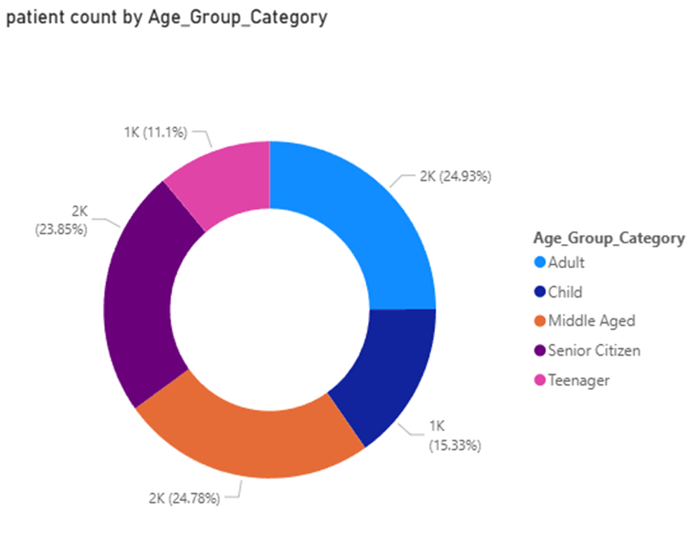
Data Analysis & Findings
Patient Age Group analysis
To better understand who our patients are and how they use our services, categorized them into five distinct age groups.
This demographic segmentation helps us tailor our care and services more effectively
Child = less than or equal to 12 years
Teenager = between 12 and 21 years
Adult = between 21 and 40 years
Middle Aged = between 40 and 60 years
Senior Citizen = 60+ years
Hence divided the overall patients into five age categories to distinguish between the age group categories & departments
INSIGHTs
Helps to conduct/plan age-specific programs & services considering the above age groups

Slide 8
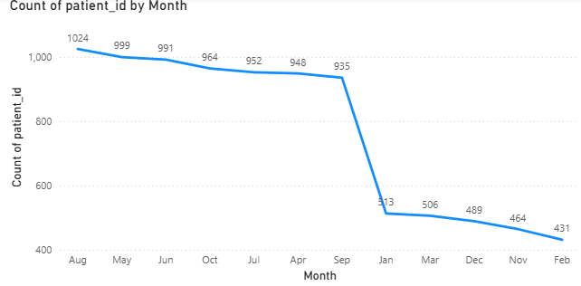
Data Analysis & Findings
Monthly patient visits
Total Patients Visited: 9,216
Seasonal Patient Flow: Monthly visit trends highlight clear seasonal patterns, helping optimize staffing and resource allocation.
Peak in August: Patient visits reach their highest in August, likely influenced by school holidays, weather conditions, or external factors.
Low in February: February shows the lowest patient traffic, making it an ideal period for facility maintenance or staff training with minimal operational impact.
Yearly Patterns: Patient visits remain strong from April to October, drop sharply in November, and stay relatively low during January–March and November–December, signaling periods of reduced demand.

Slide 9
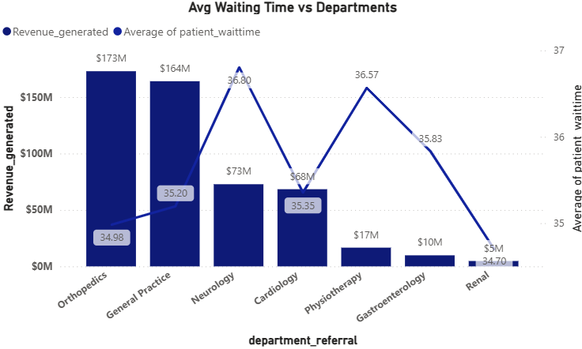
Data Analysis & Findings
Patient Wait Time analysis
Average Wait Time For Patients: 35.26 mins across hospital
Wait times range: 34.70 – 36.80 mins across the departments
Neurology has highest avg wait (36.8 mins), though difference is minimal
No critical delays — indicates efficient and balanced resource allocation
Orthopedics & General Department has generated greater revenue compared to other departments indicating the key areas of hospital
INSIGHTs
High-revenue departments present strong opportunities for targeted investments. By expanding their services and resources, the hospital can drive further growth and attract more patients.

Slide 10
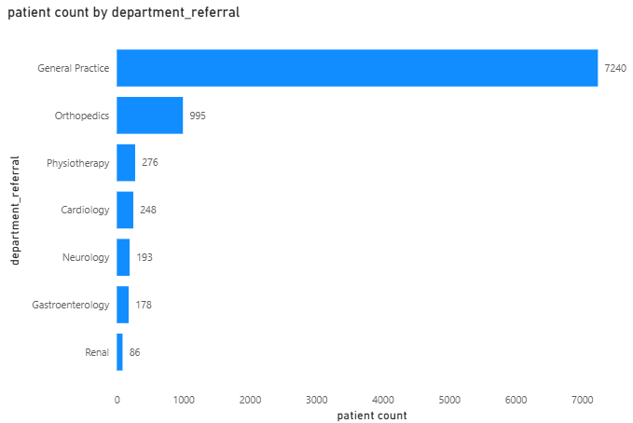
Data Analysis & Findings
Department wise Patient count
General Practice and Orthopedics had the highest patient volume, indicating these departments are essential for patient care and could benefit from increased staffing.
Renal has recorded least number of patients in overall which can help the hospital to understand the department importance while increasing the staff
INSIGHTs
The departments which recorded by greater number of patients present strong opportunities for targeted investments.
Prioritizing these departments for staffing and resource allocation could help manage demand and improve patient flow.

Slide 11
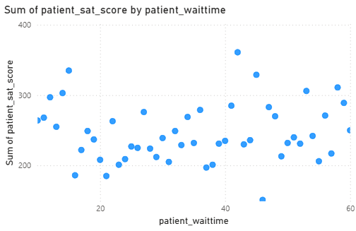
Data Analysis & Findings
Wait time Impact on Satisfaction Score
The chart shows the relationship between patient wait time and the sum of patient satisfaction scores which is having negative correlation. As wait times increase, satisfaction scores generally trend downward, though there are fluctuations. This suggests that longer wait times negatively impact patient satisfaction, highlighting the need for better scheduling and resource management to improve patient experience.
The Interpretation of Correlation = 0.51
INSIGHTs
Efforts to reduce wait times, especially in high-demand departments, could significantly improve patient satisfaction. Additionally, implementing efficient scheduling or queue management systems could help reduce congestion during peak hours.

Slide 12
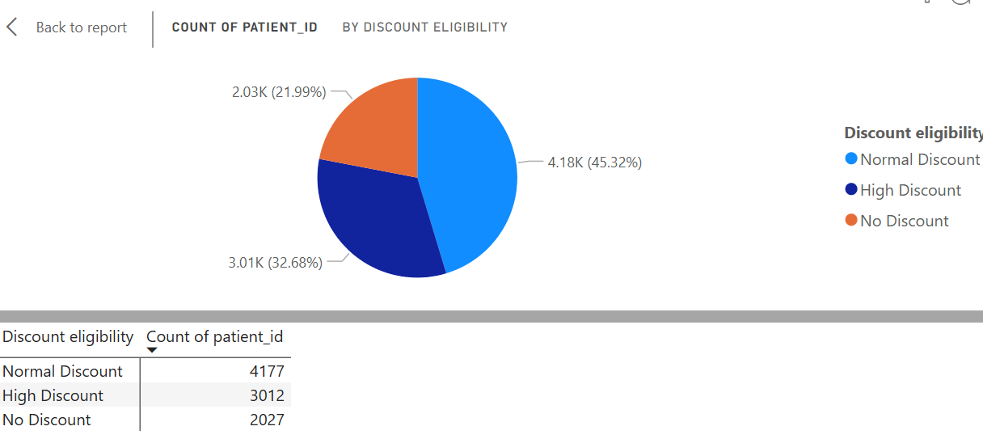
Data Analysis & Findings
Discount Eligibility for the patients based on their spend
Analyze the relationship between discount levels and patient satisfaction to assess the effectiveness of discounts on patient experience.
Normal Discount: Set at 20% of the average spend (~15K). This creates a reasonable entry point for patients to qualify.
High Discount: Set at 90% of the average spend (~50K). This ensures only significantly high spenders qualify
INSIGHTs
Around 22% of patients qualify for the High Discount, as their total bill exceeds 35K.
About 45% of patients fall into the Normal Discount category, with total bills between 15K and 35K.

Slide 13
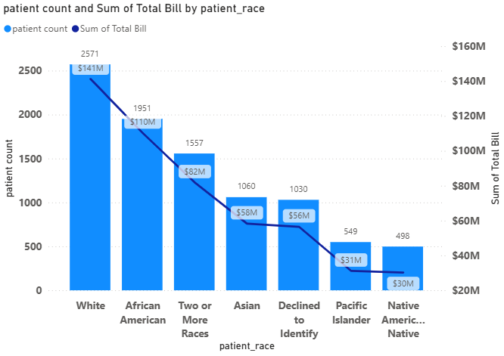
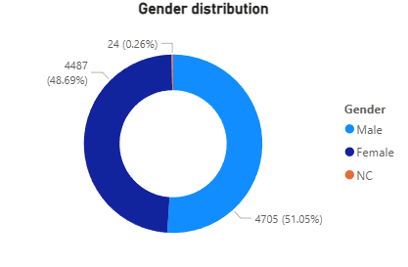
Data Analysis & Findings
Demographic Analysis
gender analysis
INSIGHTs
There is no much difference in gender as Male & Female have generated around ~99% where as ~51% Male and ~48 Female Patients were recorded
In Demographic Analysis we can notice that White race have generated revenue around ~27% overall and greater than other races as well. This can be used while hospital is planning to start a new branches.

Slide 14
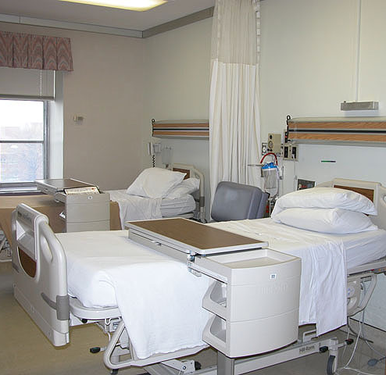
Patient Satisfaction Growth
Analysis
Patient Satisfaction Rate
Patient satisfaction scores vary significantly across different age groups and racial demographics, with some groups consistently reporting lower satisfaction.
Recommendations:
Develop targeted patient engagement strategies for age groups and racial demographics showing lower satisfaction scores.
Customize services and communication based on demographic needs to provide a more personalized patient experience.

Slide 15

Staff Hire Strategy
Analysis
Staffing & Growth
Strategic Doctor Hiring: General Practice Department: With over 7,200 patient visits and only 3 doctors currently managing the load, it is highly recommended to recruit 2–3 additional general practitioners.
This expansion will reduce strain on the existing team, enhance service quality, and significantly improve patient access and wait times.
Hospital Profitability Overview: Columbia Asia Hospital displays strong and stable financial performance, with consistently high profitability. This solid financial footing provides the flexibility to invest confidently in staff expansion and patient-centered initiatives, ensuring continued growth and operational excellence.

Slide 16

Discount Strategy
Analysis
Discount Eligibility
Patients receiving medium to high-level discounts based on their total bill
Recommendations:
Introduce loyalty discounts or follow-up visit discounts to encourage repeat visits and build long-term patient relationships. Provide special discounts for senior citizens and long-term patients to enhance trust and goodwill.
Introduce seasonal wellness packages (e.g., winter immunity or summer hydration checkups) with bundled discounts to attract patients during off-peak periods.

Slide 17
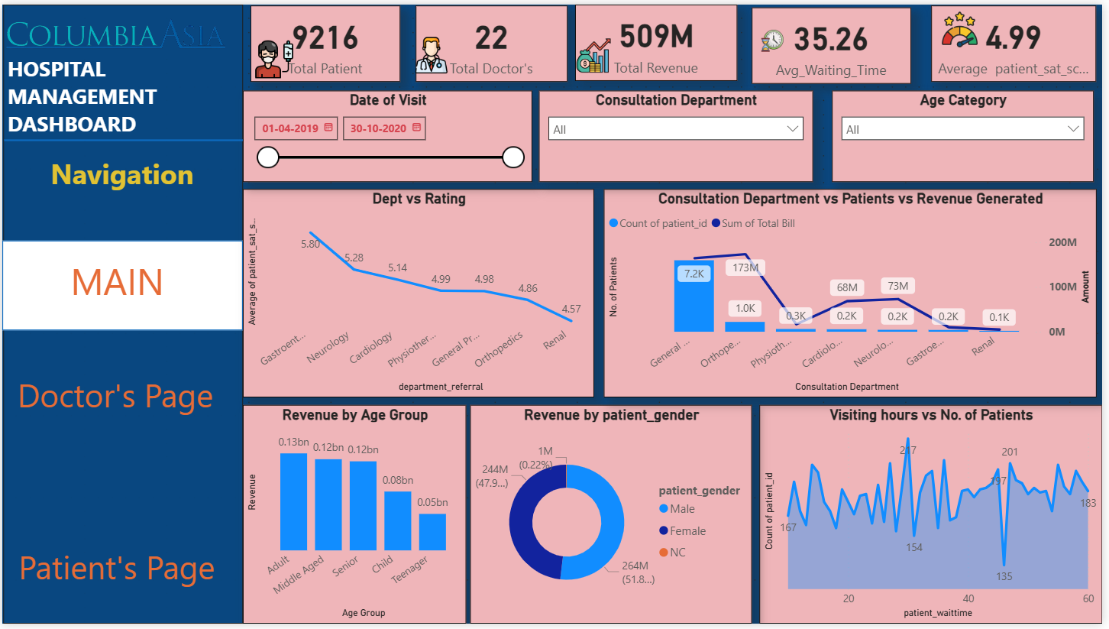

MAIN PAGE

Slide 18
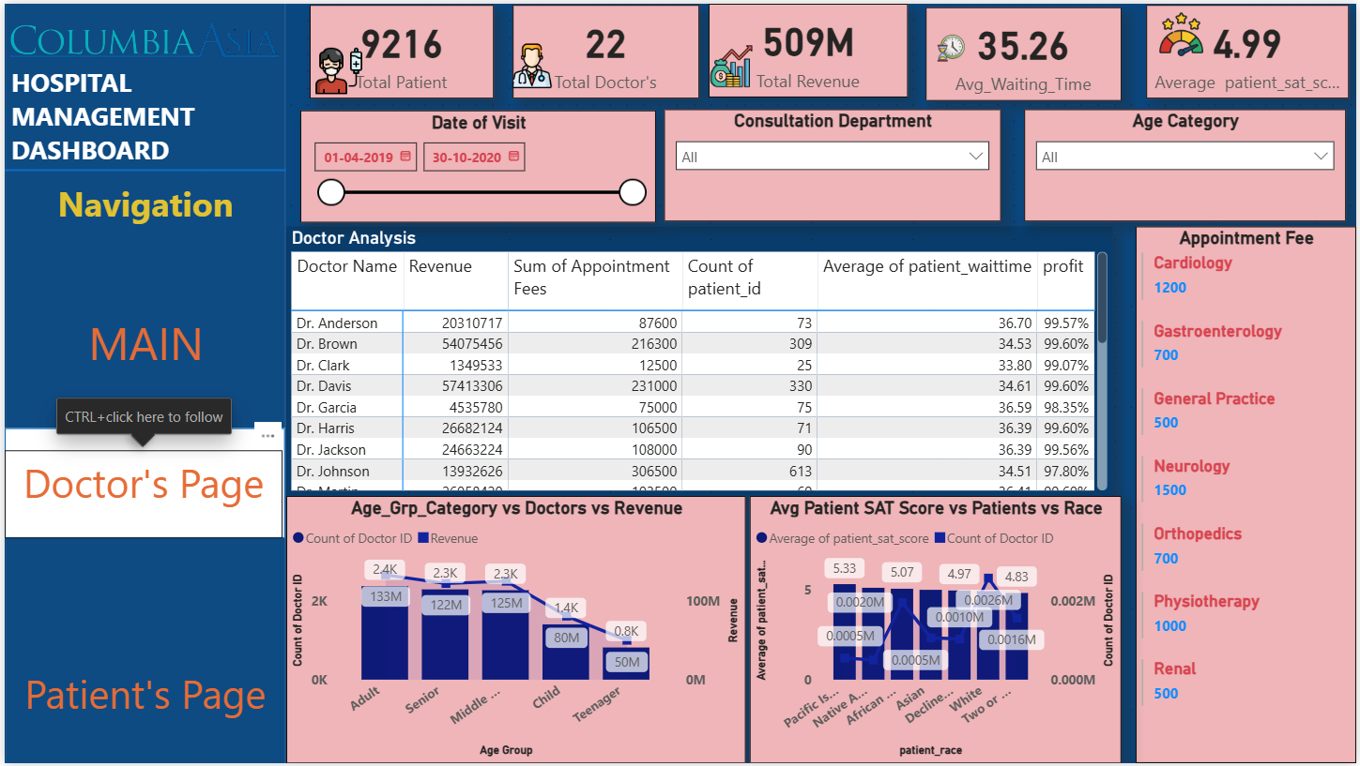
Doctor’s Page

Slide 19
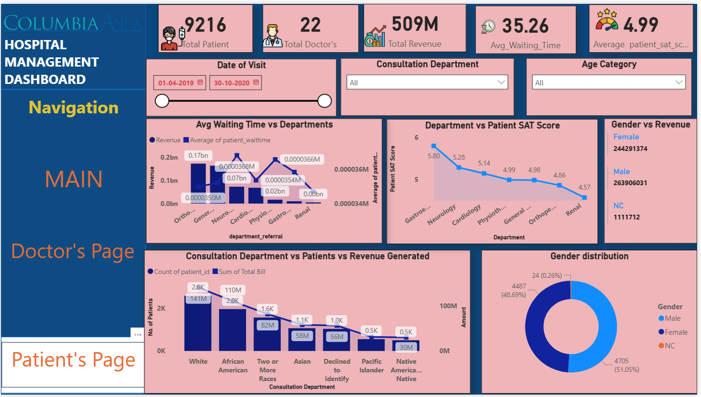

Paitent’s Page

Slide 20

Conclusion :
Columbia Asia Hospital displays strong and stable financial performance, with consistently high profitability. This solid financial footing provides the flexibility to invest confidently in staff expansion and patient-centered initiatives, ensuring continued growth and operational excellence. It focusses on improving he patient satisfaction score by offering quality treatment with high qualified staff

Slide 21


Acknowledgements
🏫 Institutional Support
This project was conducted under the guidance and academic framework of Newton School, ensuring structured learning and real-world application.
👏 Mentorship Acknowledgement
Heartfelt thanks to all the mentors whose guidance and support were invaluable throughout the analysis process. Your insights made this project possible.

Slide 22


Thank you for your attention

